Slide 1
War at Sea

Slide 2
Coral Sea
April 1942: US Magic program decoded Japanese transmissions discussing an attack on Southern New Guinea
USS Lexington and USS Yorktown were sent by Nimitz to intercept them
First naval battle ever when the surface fleets never encountered each other
4 days in May 1942 carrier planes traveled the 280km between fleets to attack enemy ships
USS Lexington was lost and USS Yorktown was damaged
Japanese lost one light carrier and damaged one heavy carrier
US lost 70 aircrafts and Japan lost 90
Battle was a draw
Strategic victory for the US, because they prevented Japan from landing in New Guinea

Slide 3
Midway (TURNING POINT!)
An increase in Japanese radio traffic, tipped the US off of an impending attack
People were worried Japan would attack the US mainland
Nimitz was advised to withdraw his force eastwards to repel such attack
However, he was tempted by the possibility of destroying a Japanese carrier force
Japan wanted to lure the US to Midway to finish what they started at Pearl Harbor
US deciphered that Japan would attack the US base at Midway
Nimitz dispatched 3 carriers to northeast Midway to surprise Japan (who thought US forces were in Hawaii)
US long-range reconnaissance plane found the 4 carrier Japanese fleet
First US attack was repulsed
Japanese fighters were too low to defend against US torpedo bombers
Within 5 minutes, 3 Japanese carriers were ablaze (the 4th sank later that day)
Japanese attack claimed the USS Yorktown
US evened the odds since Pearl Harbor (would remain industrially superior to Japan)

Slide 4
Technology of the Pacific
Magic:
Information decoded from Japanese diplomatic communications in 1940
In 1939, the Japanese began using a new coding technique; the US Signal Intelligence Service built a copy of the encryption device; codenamed Magic by the US, JN-25 by Japan
Informed US of attacks on Port Moseby and Midway in May and June of 1942, respectively
Cryptology
US search for a code; Navajo language (from Navajo nation in SW US)
Navajo language has no symbols, unwritten, multiple dialects
Navajo “code talkers” would transmit messages by telephone wire; took them 20 seconds to decode the messages; took machines 30 minutes
400 code-talkers worked in the marines; used in all of major missions
Japanese never broke the code

Slide 5
Technology of the Pacific Cont.
Nuclear Weapons
All major combatants of WWII explored nuclear weaponry
Nuclear fission first achieved in Germany in 1938
During the Roosevelt presidency
US Army Corps of Engineers tasked with creation of nuclear weaponry
Head physicist was Robert Oppenheimer
Strict security, but Soviet Spy Hans Fuchs still placed among the research
Two weapons developed; one used plutonium, the other uranium 235
First prototype dropped in New Mexico in summer of 1945

Slide 6
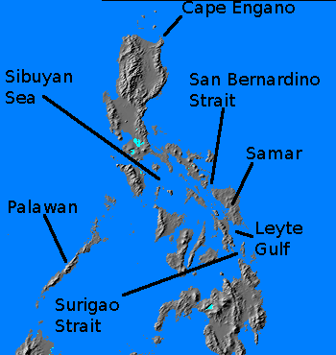
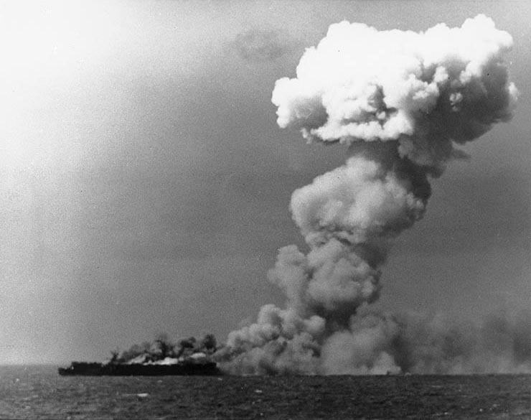
Leyte Gulf
Japanese tried to stop US landing in Philippines
Attacked naval force that supported the landing
Lured US vessels into a fight while main Japanese fleet fought towards the US invasion force
US outgunned still fought to a standstill--Japanese withdrew
Invasion force untouched

Slide 7
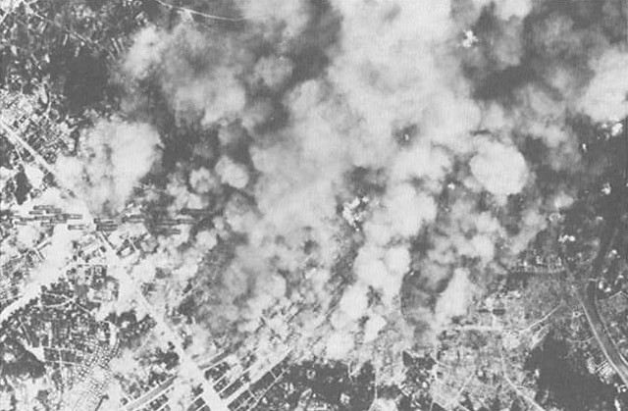
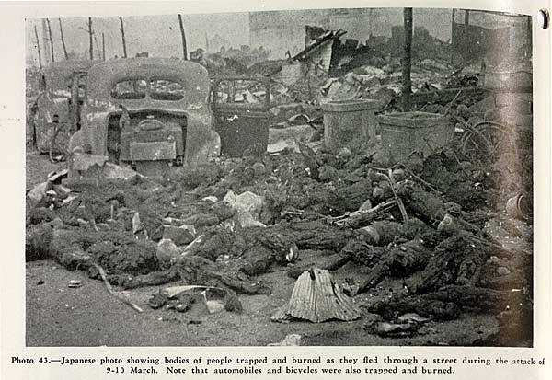
Bombing Campaign
US captured Saipan and other islands in the Marianas
Japanese home island within range of B-29s
Attacked cities with incendiary bombs
Japanese air force too weak to counter
300,000 civilian deaths & over half of Japanese urban centers destroyed
Did little damage to industrial capacity

Slide 8
The Manhattan Project
An alternative to the Japanese fire bombings
Truman begins program to assemble great scientific minds to explore ideas of nuclear fission
Directed by Robert Oppenheimer
Centered in Los Alamos, New Mexico
By Summer 1945, a prototype was created and was successful once tested.
Debates on whether to use it as an instrument of intimidation or straight up war
70 of the scientists who worked on the project wanted it used for intimidation
Truman called Oppenheimer a “cry baby scientist” and dropped the bomb without warning.

