Slide 1
Occupation of Defeated Nations

Slide 2
Austria
Viewed as a subsidiary state within the Third Reich and therefore not treated as harshly as Germany but still “Nazified” enough to be divided and occupied.
Occupation viewed as temporary until Allied agreed on government.
Divided until 1955.
Soviet occupation forces present in 1945.
A provisional government was declared and Austrian politician Karl Renner renounced the leadership of Hitler and seceded from Nazi Germany.
He called for free elections and the re-establishment of a democratic state.
Appointed pro-western cabinet members to smooth relations with all occupying forces (USSR, US, UK, France)

Slide 3
Austria
US sector, and to a lesser extent the British sector, received Marshall Plan aid and saw recovery in industry.
Soviets initially expropriated all Austrian businesses and extracted natural resources from their zone. Red Army allowed to plunder.
Soviets later changed course and tried to keep forces benevolent seeing value in the benefits being reaped by a capitalist system.
Unlike eastern Germany, collectivization and full nationalization was rejected.
Western Allies kept armed forces in place fearing invasion similar to Czechoslovakia in 1948. Korean War confirmed these fears.

Slide 4
Austria
Demilitarized by 1953
Recognizing that Austria was less important to the Soviets than the west believed, Austria began negotiations with Moscow in 1955.
Terms: Austria would pay for the cost of Soviet occupation in exchange for perpetual neutrality, it would not have foreign military bases, and Anschluss could never happen again.
May 1955 Austrian State Treaty restored Austrian independence with perpetual neutrality (Austria could join UN).
All occupying forces withdrew by the end of 1955.

Slide 5
Japan
To ensure Soviet aid against Japan, Roosevelt promised the cession of South Sakhalin and the Kurile islands to the USSR, lease rights to Port Arthur and Dairen, outer Mongolia would stay in Soviet sphere, and creation of a Sino-Soviet commission to build a railway.
After Truman witnessed Soviet treatment of occupied territory, he wanted to keep the USSR out of Asia as much as possible.
This was aided by the ability to use the atom bomb to hasten Japanese surrender.
August 14 1945—Japan surrenders unconditionally
US military was sole occupier of Japan
Korea was divided between US and USSR
Ensuing power vacuum resulted in US forces returning to Asia and British and Chinese nationalists could reassert their power.

Slide 6
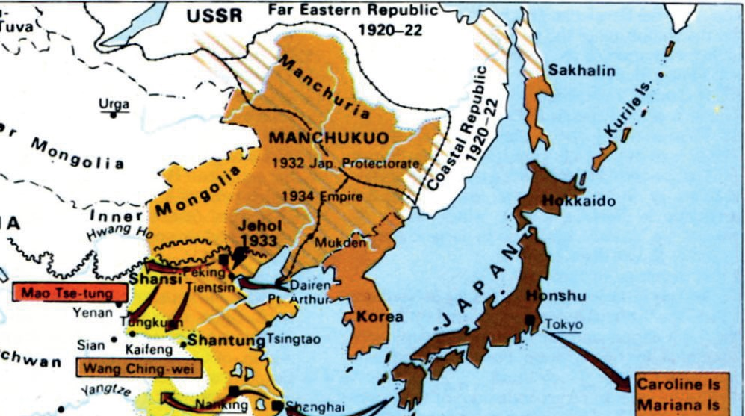

Slide 7
Japan
Despite Allied Council (China, US, US, USSR), MacArthur had final decision-making authority in Japan which was in US sphere of influence.
Political system, economy, and military were all reconstructed to US specifications.
Democracy, demilitarization, prosecution of war criminals, and economic reforms to destroy corporations seen as partly responsible for expansionist policies that led to WWII.
In 1954, the Japan Self-Defense Forces were founded as a full-scale military in all but name.
September 8 1951—San Francisco Peace Treaty ended occupation effective April 28 1952 and fully restored Japanese sovereignty
With the exception of the Ryukyu Islands until 1972

