Slide 1
Berlin Airlift

Slide 2
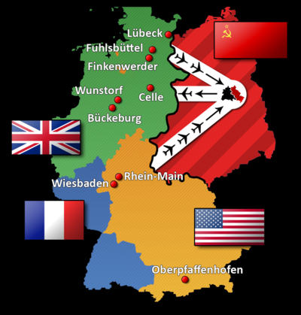
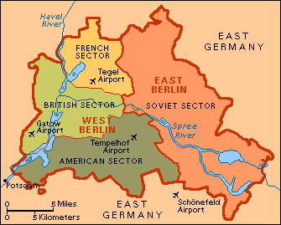

Slide 3
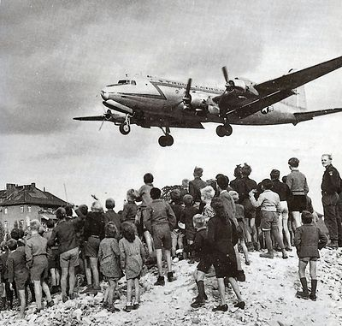

Slide 4
Discussion
Compare and contrast the treatment of Germany post WWI and WWII.
Why does occupation of Germany looks so different from occupation of Austria?
What message does the Berlin Airlift send to West Germans, East Germans, US/UK citizens, USSR citizens?
Impact?

Slide 5
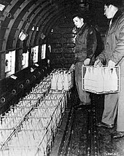
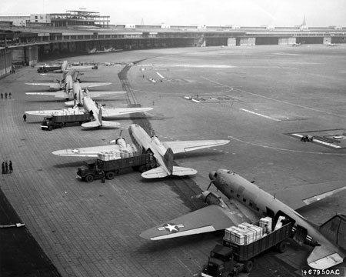

Slide 6
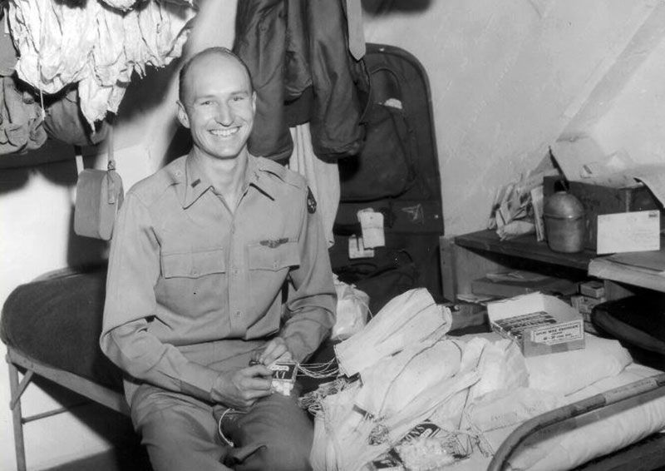
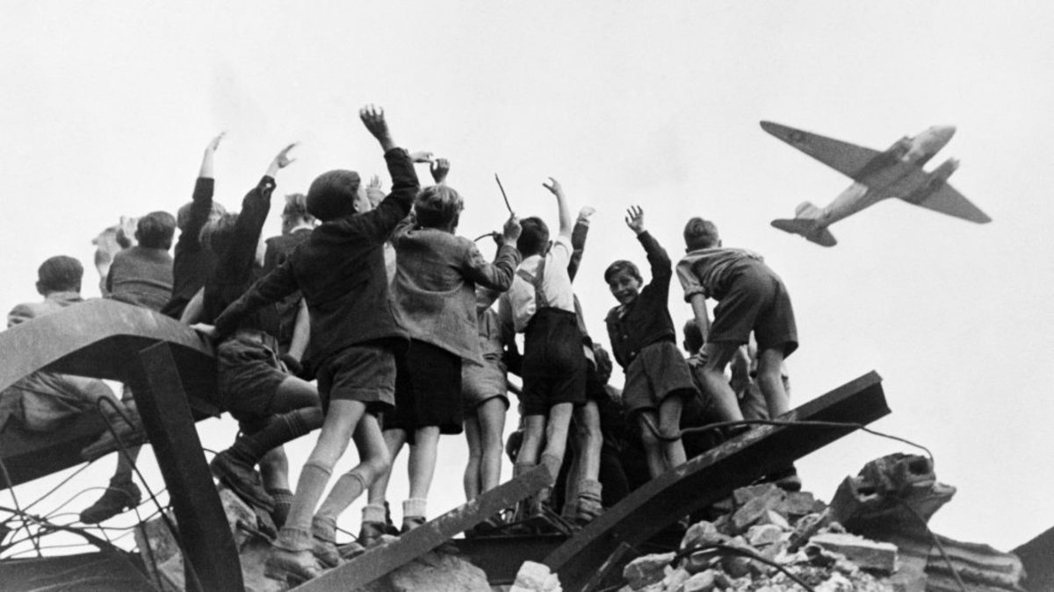
Gale Halvorsen: the Candy Bomber

Slide 7
The Big Lift (1950)
During the 1948 Berlin Airlift, as British and American forces break a Russian blockade of the divided German city, a pair of American soldiers fall in love with local women against a backdrop of increasing Cold War tensions. Ground control specialist Hank Kowalski (Paul Douglas) finds happiness with the idealistic Gerda (Bruni Löbel), but, when pilot Danny MacCullough (Montgomery Clift) falls for the beautiful, mysterious Frederica (Cornell Borchers), his friends question her motives.

Slide 8
Historiography: Origins of the Cold War

