Slide 1
Czechoslovakia 1968

Slide 2
Changes in Leadership
Kennedy assassinated in November 1963
Lyndon B Johnson, VP, assumes power and is elected in 1964.
Khrushchev lost support after the Cuban Missile Crisis and Berlin Crisis.
His domestic policies had failed to increase the standard of living and availability of consumer goods.
Ousted by Leonid Brezhnev in 1964.

Slide 3
Prague Spring
January 1968, Alexander Dubcek took control of the Communist Party of Czechoslovakia (CPCS).
He was replacing a corrupt and stagnant regime.
Dubcek was a charismatic advocate of political reform.
Summer 1968 he advocated and implemented liberalizing policies in Czechoslovakia.

Slide 4
Dubcek’s Plan
Maintain socialism while respecting the countries democratic past and align economic policies with global realities.
1968 Action Program: achieve socialism through a distinct Czechoslovak path
Basic freedoms of speech, press, and movement
Freedom for economic enterprises to make decisions based on consumer demand rather than gov. targets.
Increased rights of autonomy for politically repressed Slovak minority

Slide 5
Reaction
Governments of Eastern Europe alarmed, USSR decides to watch to see how far reforms go.
When no clear opposition emerged reformers took things further:
Ending all press censorship
Planning to open borders with the West and discussing trade agreements with West Germany
Reformers still insisted Czech. was a loyal member of the socialist order and wanted to liberalize within Marxism-Leninism framework.

Slide 6
Warsaw Pact conducts military exercises in Czech.
Meetings of other Eastern Bloc countries
Warsaw Letter: affirmed Czech right to internal self-determination but saw challenge to socialism in one country as a threat to socialist unity and entire movement.
Brezhnev pressured Dubcek to repeal reforms—doesn’t work, Dubcek convinced Soviets would not invade.
Soviet’s hoped for a split in the party that would lead to a pro-Soviet group that would ask for military assistance.

Slide 7
He was wrong . . .
International condemnation of Soviet action in Hungary kept Brezhnev from acting alone.
Kremlin divided, but ultimately Brezhnev acted out of a sense of vulnerability if reforms spread.
August 20 1968 Warsaw Pact tanks entered Czechoslovakia and quickly took Prague.
Czech army ordered to avoid confrontation
Radio stations alerted the world.
Dubcek and gov. members arrested and forced to sign a repeal of reforms.

Slide 8
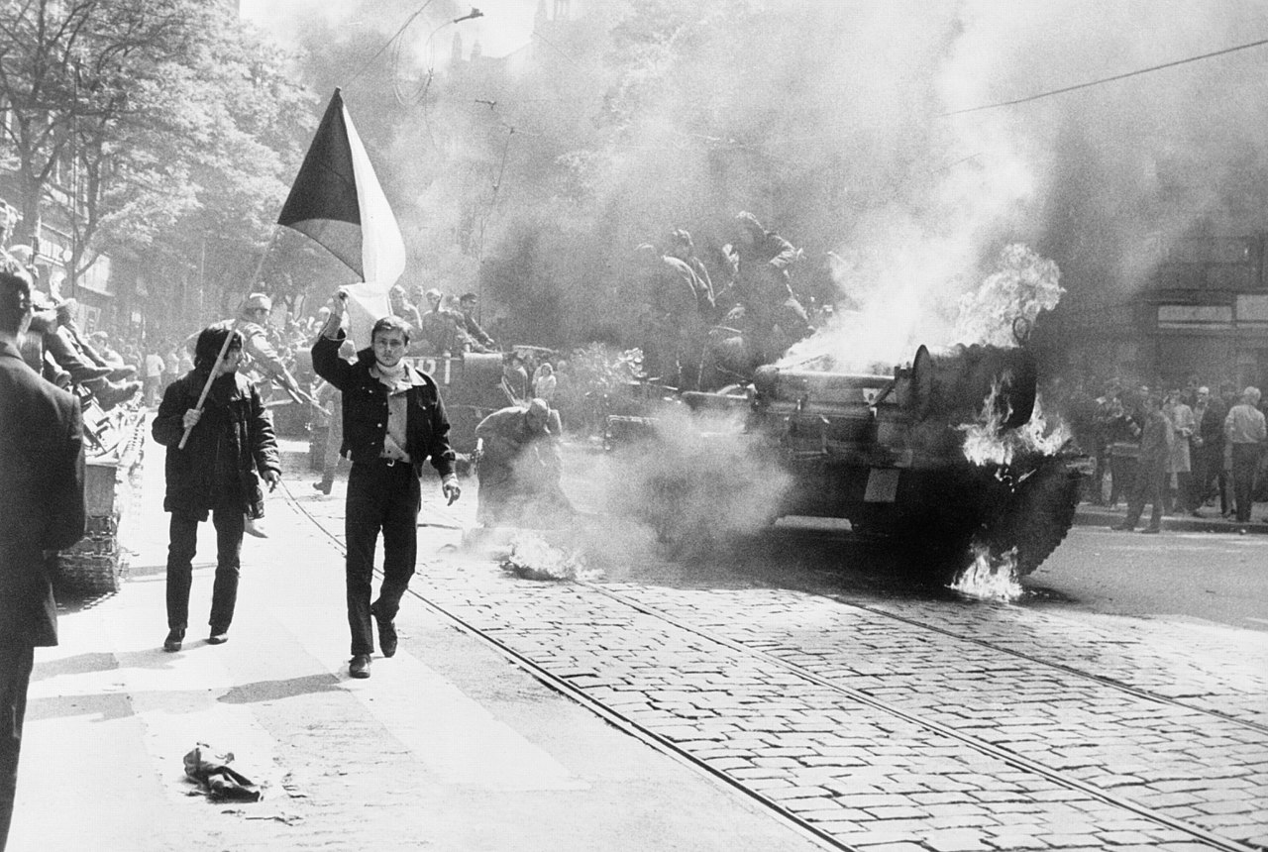

Slide 9
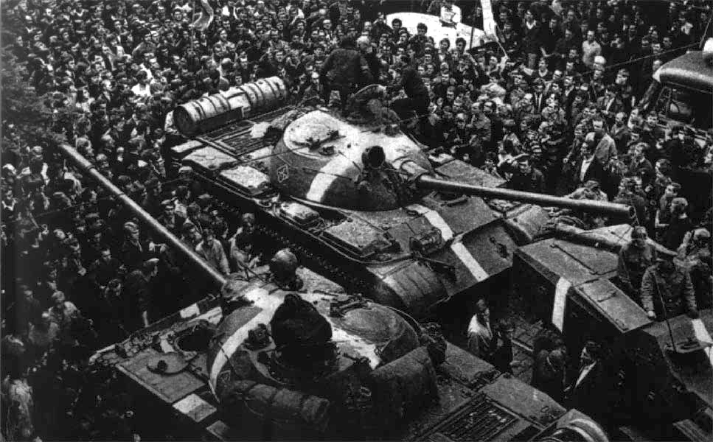

Slide 10
Impact
US/NATO condemned invasion, UN can’t pass resolution b/c Soviet veto
Rather than establish unity, the invasion showed the level of discontent in the Soviet sphere and USSR itself.
Soldiers told invasion was requested by Czech people, realized leaders had lied, hesitant to act-especially against unarmed protesters-and brought eyewitness accounts back home.
New Czech gov. dependent on continued Soviet military presence to retain power (until 1990).
Economic policies prevented general revolt: health care, employment, pensions

Slide 11
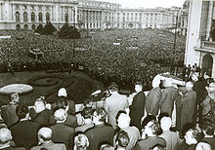

Slide 12
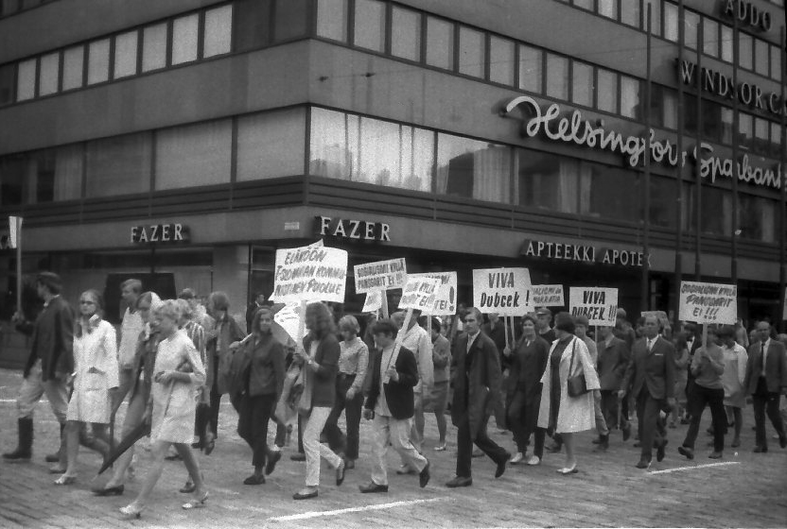

Slide 13
Brezhnev Doctrine
Soviet Union was determined to keep in place communist regimes that existed and would not allow them to be overthrown internally or externally.
This cemented the Sino-Soviet split--China feared it would be used against them while in the midst of Cultural Revolution
US decided to interpret it as defensive—until 1979 when the Soviets invaded Afghanistan.

